Slide 1
Python
Unit 2

Slide 2
1. Python Data Types
Data types define the type of value a variable can store.
Main Python Data Types
Data Type | Example
int | 10
float | 10.5
complex | 2 + 3j
str | "Python"
list | [1,2,3]
tuple | (1,2,3)
dict | {"name":"Ram"}
bool | True / False

Slide 3
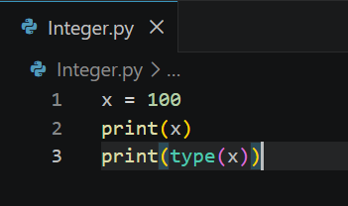
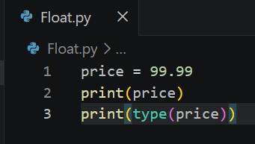
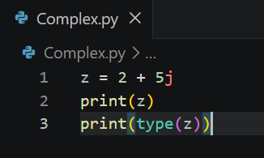
2. Numeric Data Types
Integer (int)
Integers are whole numbers without decimal points.
Float
Float stores decimal values.
Complex Number
Complex numbers contain real and imaginary parts.

Slide 4
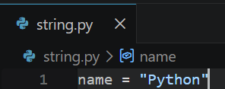
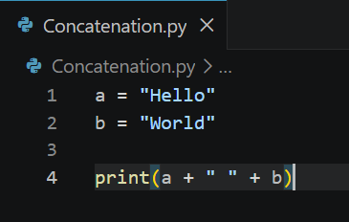
3. String Data Type and String Operations
What is String?
A string is a sequence of characters enclosed in quotes.
String Operations
1. Concatenation

Slide 5
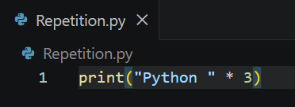
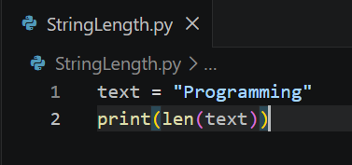
3. String Data Type and String Operations
2. Repetition
3. String Length

Slide 6
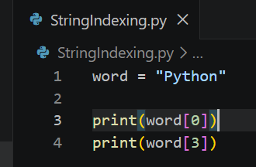
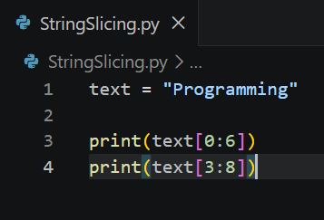
3. String Data Type and String Operations
4. String Indexing
5. String Slicing

Slide 7
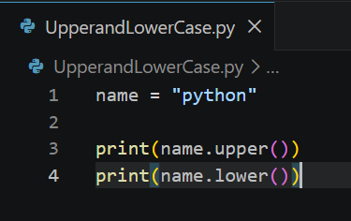
3. String Data Type and String Operations
6. Upper and Lower Case

Slide 8
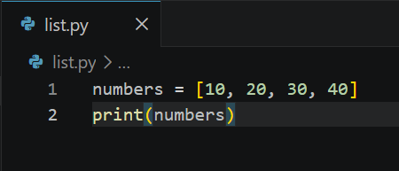
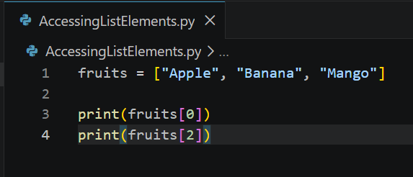
4. List and List Slicing
What is List?
A list is a collection of multiple items stored in square brackets [].
Lists are mutable (changeable).
Accessing List Elements

Slide 9
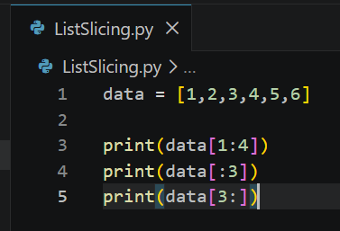
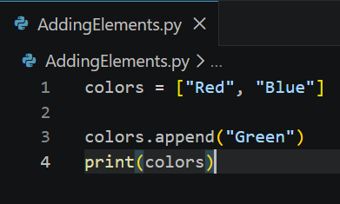
4. List and List Slicing
List Slicing
Adding Elements

Slide 10
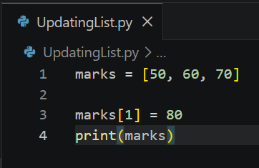
4. List and List Slicing
Updating List

Slide 11
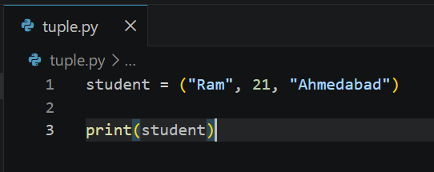
5. Tuple Data Type
What is Tuple?
A tuple is a collection of items stored in parentheses ().
Tuples are immutable (cannot be changed).

Slide 12
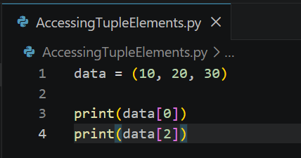
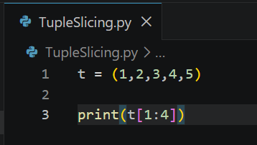
5. Tuple Data Type
Accessing Tuple Elements
Tuple Slicing

Slide 13
6. Python Program Flow Control
Flow control decides the order in which statements execute.
Python supports:
Conditional Statements
Loops
Loop Control Statements

Slide 14
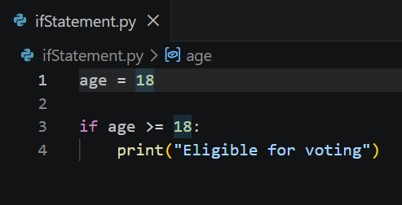
7. Conditional Blocks using if, else and elif
if Statement

Slide 15
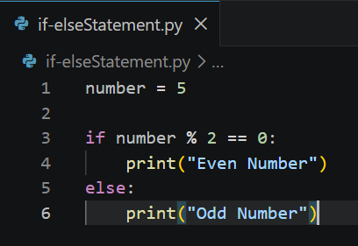
7. Conditional Blocks using if, else and elif
if-else Statement

Slide 16
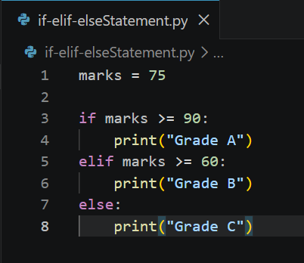
7. Conditional Blocks using if, else and elif
if-elif-else Statement

Slide 17
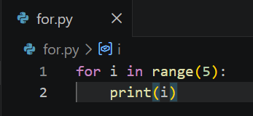
8. Simple for Loops in Python
A for loop is used to repeat statements multiple times.

Slide 18
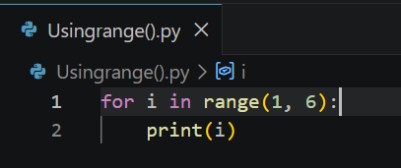
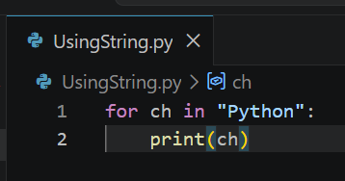
9. for Loop using Range, String, List and Dictionary
Using range()
Using String

Slide 19
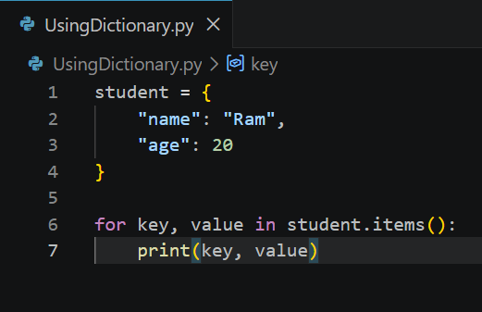
9. for Loop using Range, String, List and Dictionary
Using Dictionary

Slide 20
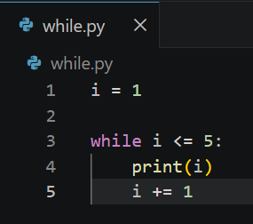
10. while Loops in Python
A while loop runs until the condition becomes False.

Slide 21
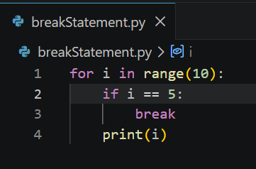
11. Loop Manipulation Statements
1. break Statement
Stops the loop immediately.

Slide 22
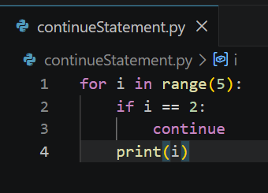
11. Loop Manipulation Statements
2. continue Statement
Skips current iteration.

Slide 23
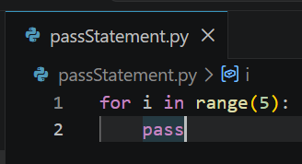
11. Loop Manipulation Statements
3. pass Statement
Used as a placeholder.

Slide 24
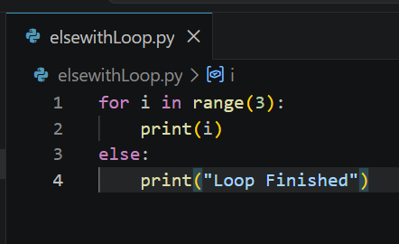
11. Loop Manipulation Statements
4. else with Loop
else executes when loop finishes normally.

Slide 25
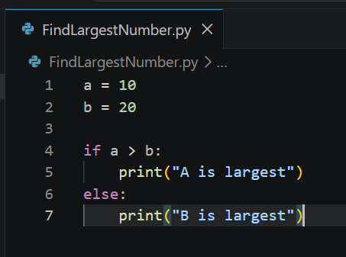
12. Programming using Python Conditional and Loops Block
Program 1: Find Largest Number

Slide 26
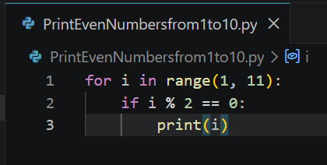
12. Programming using Python Conditional and Loops Block
Program 2: Print Even Numbers from 1 to 10

Slide 27
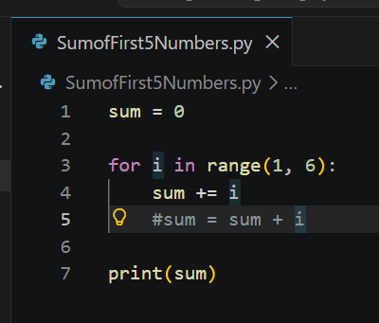
12. Programming using Python Conditional and Loops Block
Program 3: Sum of First 5 Numbers

